Slide 1
IPv6 and CGNAT: An Inevitable Team-Up in Vivacom's Network

Slide 2
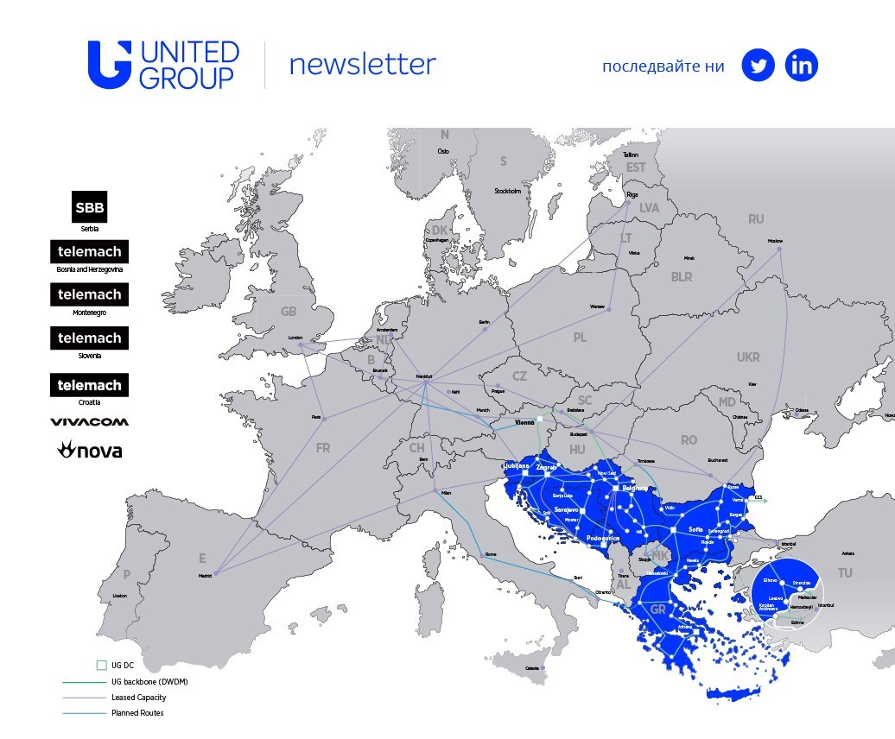



About Vivacom Bulgaria EAD
    Former incumbent operator, the largest in Bulgaria – Bulgarian Telecommunication Company (BTC)
    In 2004 a privatization procedure was started, and the Bulgarian government sold 65% of BTC
    Since Mid-2020 become part of United group - a leading telecommunications and media operator in Southeast Europe
    Currently the largest telecom in Bulgaria providing Unlimited 5G Mobile plans, EON TV service, 10G fiber access speeds for Internet, DTH TV and IPVPN business services
    VIVACOM has received the award for the fastest mobile network in Europe for the Q1-Q2 2020 period according to results from tests taken with Speedtest® by Ookla®
    VIVACOM Plana Teleport is a member of the World Teleport Association and in 2017 achieved full Tier 4 certification

Slide 3


CGNAT timeline
2004 - ADSL services - no CGNAT (Broadband Verification stats)
2007 - Mobile operator - CGNAT from the start
2011 - Fixed Broadband services AON/GPON - no CGNAT (Broadband Verification stats)
Dec.2021 - CGNAT introduced for AON/GPON
All new BB subs in CGNAT
Existing BB subs migrated to CGNAT after contract renewal
Why ?
Millions of mobile subscribers
Hundreds of thousands of fixed BB subs
Severe IPv4 shortage
Increasing cost for buying and renting IPv4s

Slide 4




CGNAT – The reality
Still requires Public IPv4s for NAT Outside pools
Licensing
HW - Limited Capacity, Rack space/Routers slot space/EOL/EOS/Backup/Spares
DynNAT logging -> FlowExport/Radius Acct or Use Deterministic NAT
Logging servers need maintenance
Complicates the network configs – CGNAT bypass
Blacklists

Slide 5

IPv6 timeline
Nov.2007 2a01:5a8::/32 allocation
Aug.2009 First business customer on Dual Stack
2009 IPv6 available to Business customers only (on BRs or IPv6 only in VPRN)
2011 IPv6 enabled on Vivacom's DNS caches
Jan.2020 - Start of early tests of IPv6 for BB services on BNGs
Apr.2020 - Full IPv6 routing table available on each BNG (moved IPv6 Cust to the Edge)
Dec.2021 - IPv6 enabled for Mobile subs (CGNAT HW Offload)
Feb.2022 - Started working on IPv6 for fixed BB subs (AAA/ACS/OLTs/ONTs/CPEs/LLD)
Feb.2023 - Start of gradually enabling IPv6 for GPON subs
Jun.2023 - IPv6 enabled for all GPON subs
Cache farms on IPv4/IPv6 from day one - FB,GGC,NetFlix,Akamai,Cloudflare …

Slide 6
Dual Stack overview
Mobile
Dual-Stack – Public or Private IPv4, /64 IPv6 Dynamic or Static
/64 for all - Smartphones/Tablets/FWA CPEs
(Really straightforward implementation)
Fixed
Dual-Stack for GPON Subs - Public or Private IPv4, /128 WAN and /64 PD (IPv6 only dynamic)
DHCPv6 only access
IPoE sessions on BNGs (Single Auth for IPv4/IPv6)
Authentication based on Opt82-Circ-Id/Interface-Id Opt-18
Dynamic allocation of /128 on WAN + /64 PD for ONT/CPE LAN.
SLAAC behind the ONT/CPE
Radius-Accounting for IPv6

Slide 7

What had to be done?
Low Level design for Dual Stack on BNGs
IP Core BNGs configuration
AAA/ACS development
DHCPv6 Security features in the access infrastructure
ONTs/CPEs tests and software upgrade / TR-69 for IPv6
OLTs configuration (DHCPv6 snooping)
IPv6 activation on ONTs
Training

Slide 8
Traffic charts

Slide 9
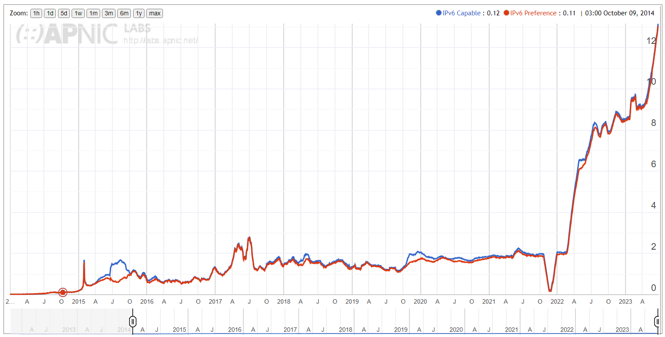
APNIC IPv6 stats for Bulgaria

Slide 10

IPv6 and NAT team-up
Apparently inevitable for us
Cost reduction and native access to IPv6 enabled resources
Surprisingly smooth and problem free implementation
Future proof and sustainable (340 undecillion IPv6 addresses and increasing IPv6 traffic, CGNAT Offload)
Future Plans
IPv6 as much as possible

